Slide 1


BIT07 – Machine Learning
Cedric Hermans

Slide 2
Decision trees

Slide 3
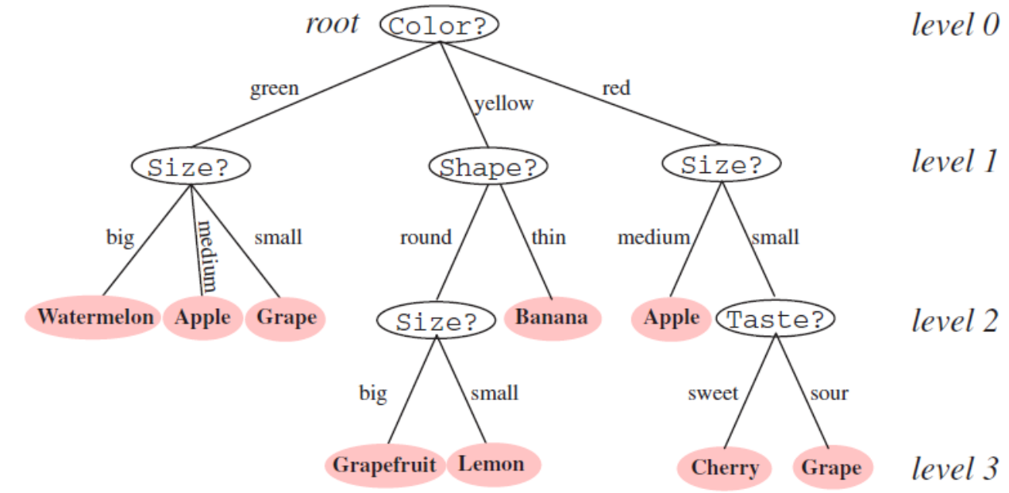
Decision trees
Example decision tree
Root
Branch
Node
Leaf Terminal node

Slide 4
Decision trees
Benefits of decision trees
Interpretability: a tree can be expressed as a logical expression
Rapid classification: a sequence of simple queries
Higher accuracy & speed
Disadvantages
Prone to overfitting

Slide 5
Decision trees
Building a decision tree
To make a decision tree, two metrics are used
Entropy
Disorder of the data
More disorder => higher entropy
Information Gain
If we would split the data according to a specific rule, what would be the information we get out of it?

Slide 6
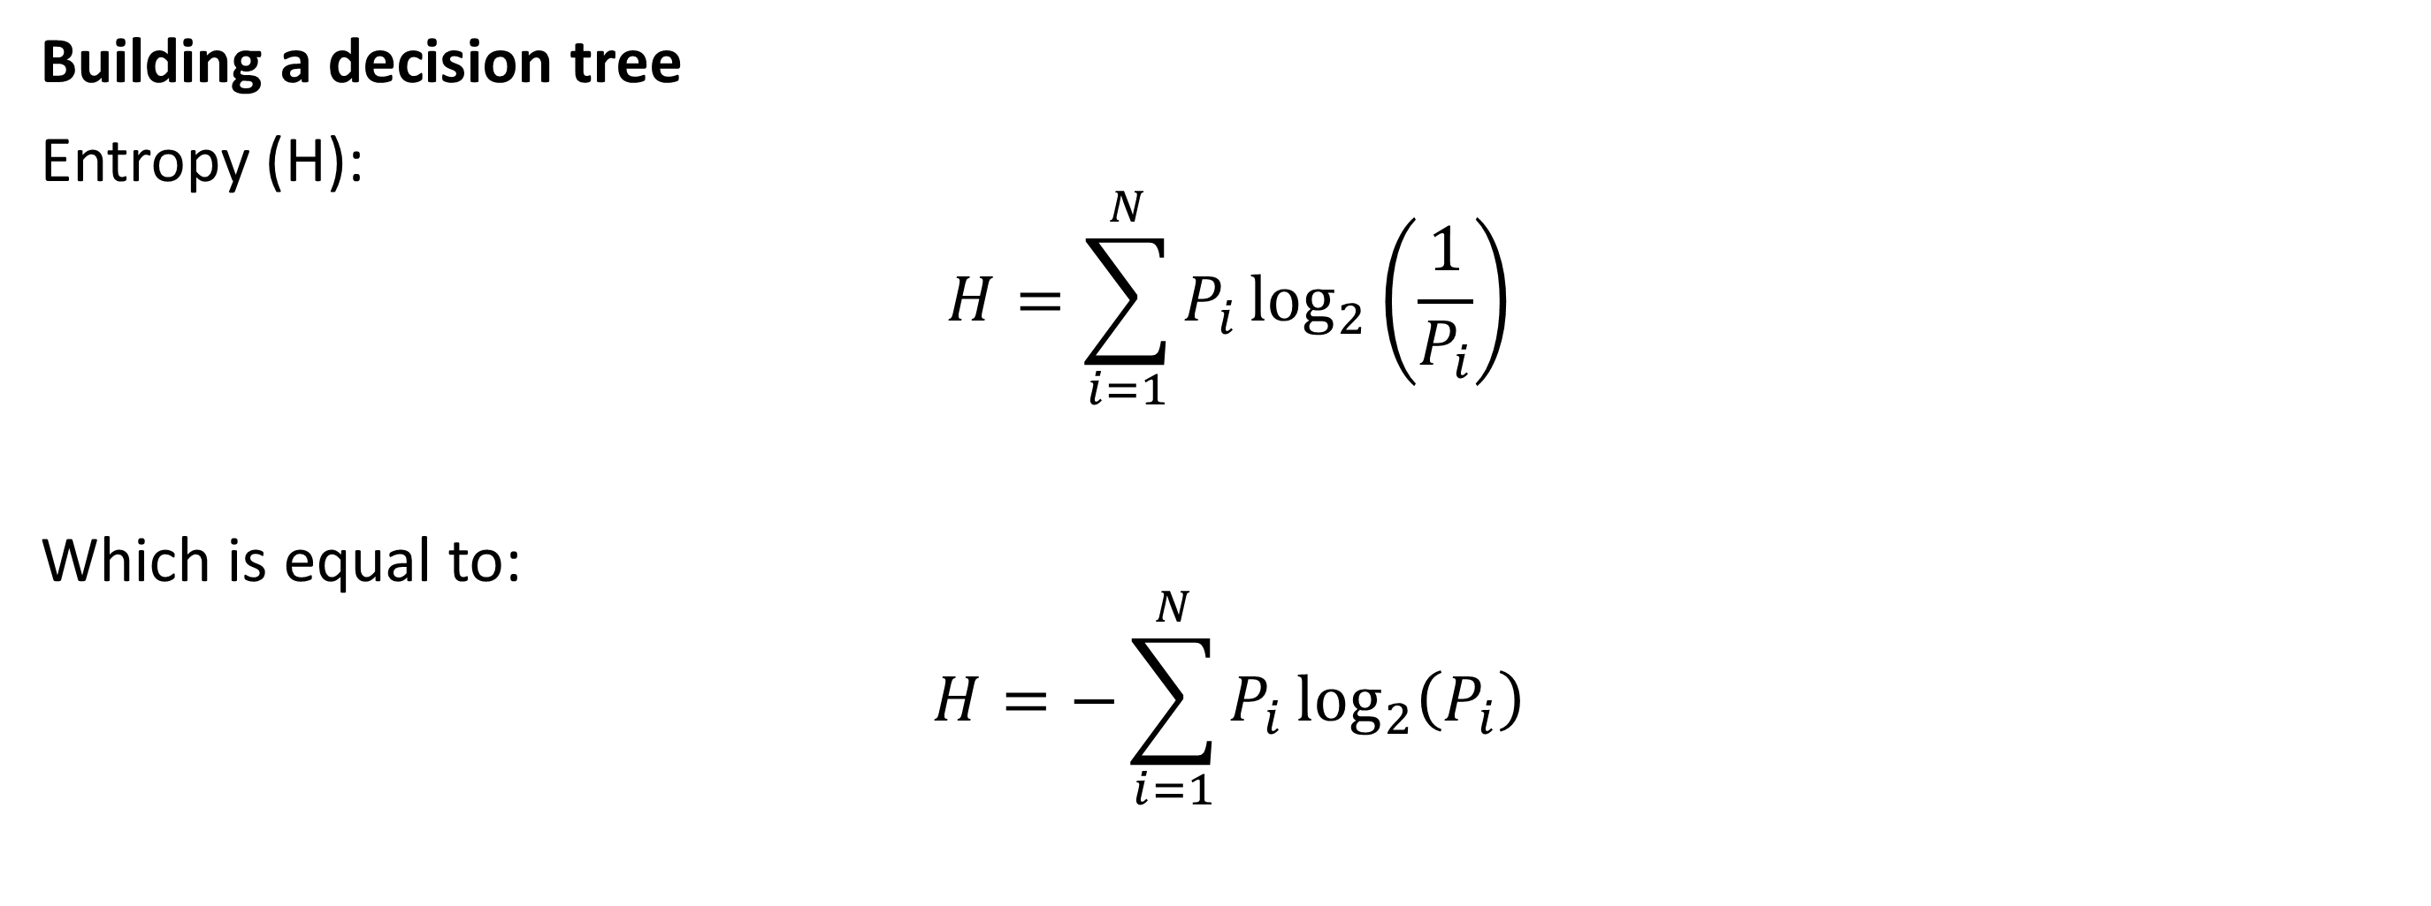
Decision trees
Building a decision tree
Entropy (H):
$$H=\sum_{i=1}^{N}{P_{i}\log_{2}\left(\frac{1}{P_{i}}\right)}$$
Which is equal to:
$$H=−\sum_{i=1}^{N}{P_{i}\log_{2}\left(P_{i}\right)}$$

Slide 7
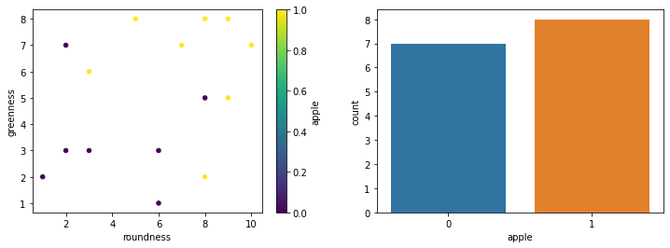
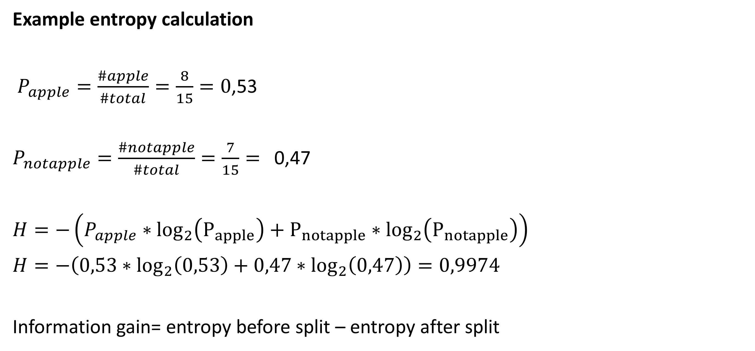
Decision trees
Example entropy calculation
$P_{apple}=\frac{\#apple}{\#total}=\frac{8}{15}=0$,53
$P_{notapple}=\frac{\#notapple}{\#total}=\frac{7}{15}=$ 0,47
$H=−\left(P_{apple}∗\log_{2}\left(P_{apple}\right)+P_{notapple}∗\log_{2}\left(P_{notapple}\right)\right)$
$H=−\left(0,53∗\log_{2}\left(0,53\right)+0,47∗\log_{2}\left(0,47\right)\right)=0,9974$
Information gain= entropy before split – entropy after split

Slide 8
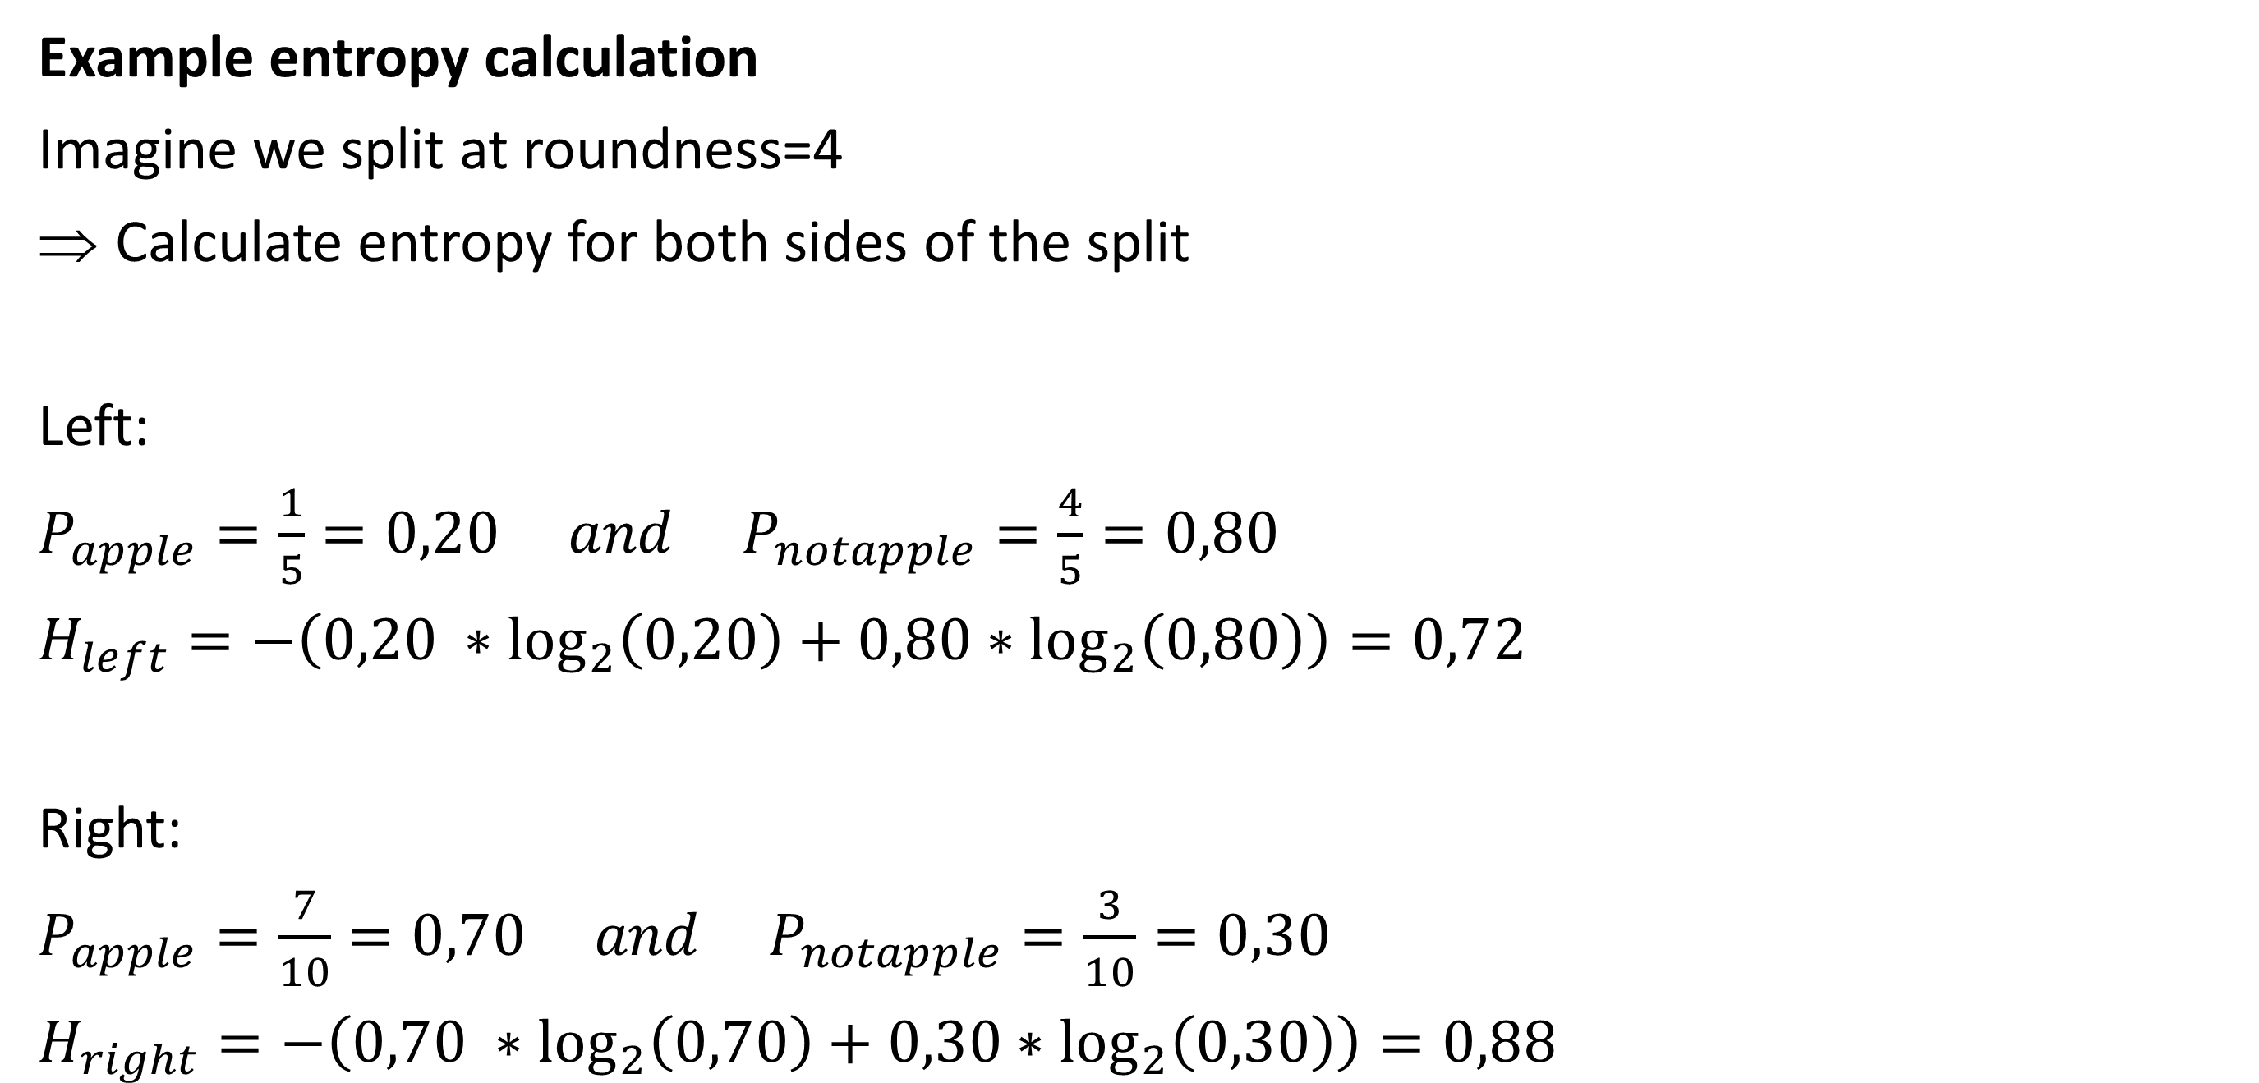
Decision trees
Example entropy calculation
Imagine we split at roundness=4
Calculate entropy for both sides of the split
Left:
$P_{apple}=\frac{1}{5}=0,20 and P_{notapple}=\frac{4}{5}=0,80$
$H_{left}=−\left(0,20 ∗\log_{2}\left(0,20\right)+0,80∗\log_{2}\left(0,80\right)\right)=0,72$
Right:
$P_{apple}=\frac{7}{10}=0,70 and P_{notapple}=\frac{3}{10}=0,30$
$H_{right}=−\left(0,70 ∗\log_{2}\left(0,70\right)+0,30∗\log_{2}\left(0,30\right)\right)=0,88$

Slide 9
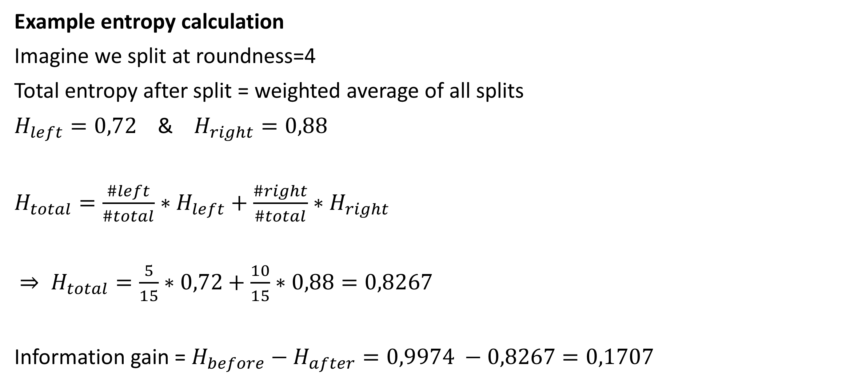
Decision trees
Example entropy calculation
Imagine we split at roundness=4
Total entropy after split = weighted average of all splits
$H_{left}=0,72$ & $H_{right}=0,88$
$H_{total}=\frac{\#left}{\#total}∗H_{left}+\frac{\#right}{\#total}∗H_{right}$
$⇒ H_{total}=\frac{5}{15}∗0,72+\frac{10}{15}∗0,88=0,8267$
Information gain = $H_{before}−H_{after}=0,9974 −0,8267=0,1707$

Slide 10
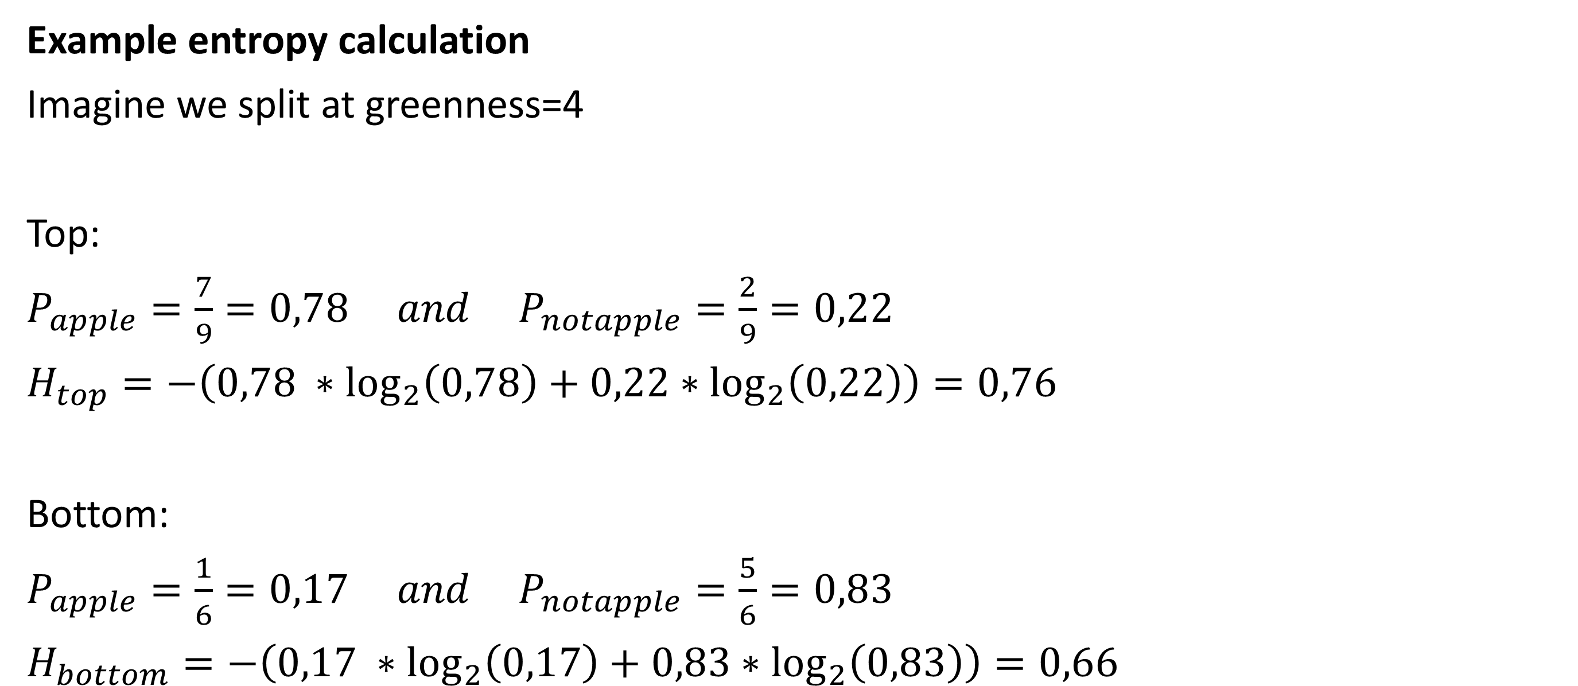
Decision trees
Example entropy calculation
Imagine we split at greenness=4
Top:
$P_{apple}=\frac{7}{9}=0,78 and P_{notapple}=\frac{2}{9}=0,22$
$H_{top}=−\left(0,78 ∗\log_{2}\left(0,78\right)+0,22∗\log_{2}\left(0,22\right)\right)=0,76$
Bottom:
$P_{apple}=\frac{1}{6}=0,17 and P_{notapple}=\frac{5}{6}=0,83$
$H_{bottom}=−\left(0,17 ∗\log_{2}\left(0,17\right)+0,83∗\log_{2}\left(0,83\right)\right)=0,66$

Slide 11
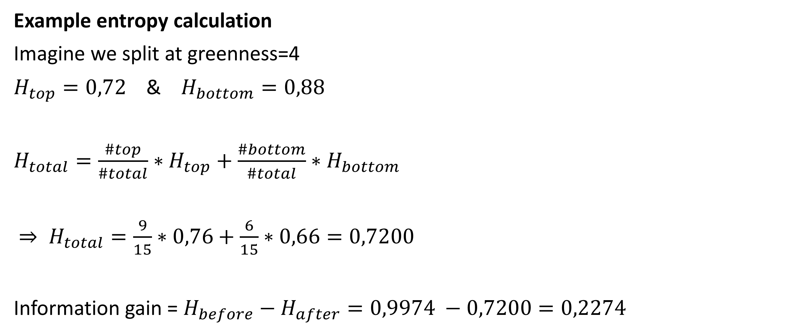
Decision trees
Example entropy calculation
Imagine we split at greenness=4
$H_{top}=0,72$ & $H_{bottom}=0,88$
$H_{total}=\frac{\#top}{\#total}∗H_{top}+\frac{\#bottom}{\#total}∗H_{bottom}$
$⇒ H_{total}=\frac{9}{15}∗0,76+\frac{6}{15}∗0,66=0,7200$
Information gain = $H_{before}−H_{after}=0,9974 −0,7200=0,2274$

Slide 12
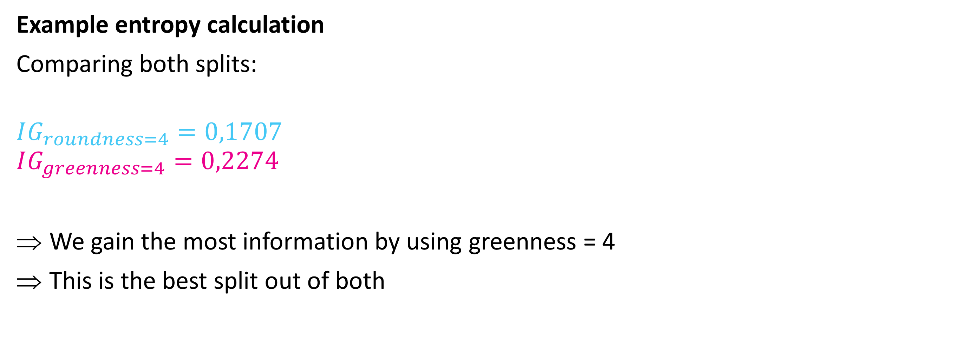
Decision trees
Example entropy calculation
Comparing both splits:
$$IG_{roundness=4}=0,1707$$
$$IG_{greenness=4}=0,2274$$
We gain the most information by using greenness = 4
This is the best split out of both

Slide 13
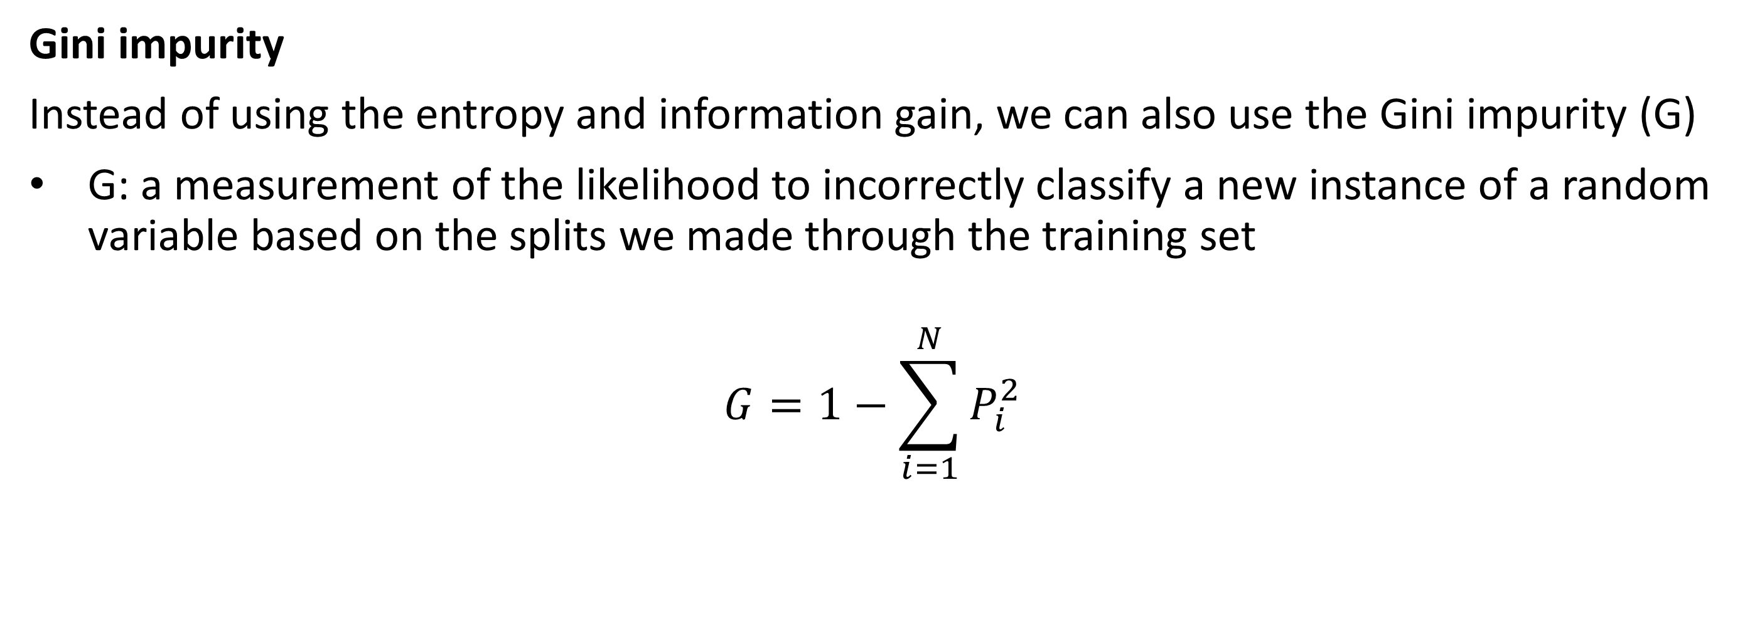
Decision trees
Gini impurity
Instead of using the entropy and information gain, we can also use the Gini impurity (G)
G: a measurement of the likelihood to incorrectly classify a new instance of a random variable based on the splits we made through the training set
$$G=1−\sum_{i=1}^{N}{P_{i}^{2}}$$

Slide 14
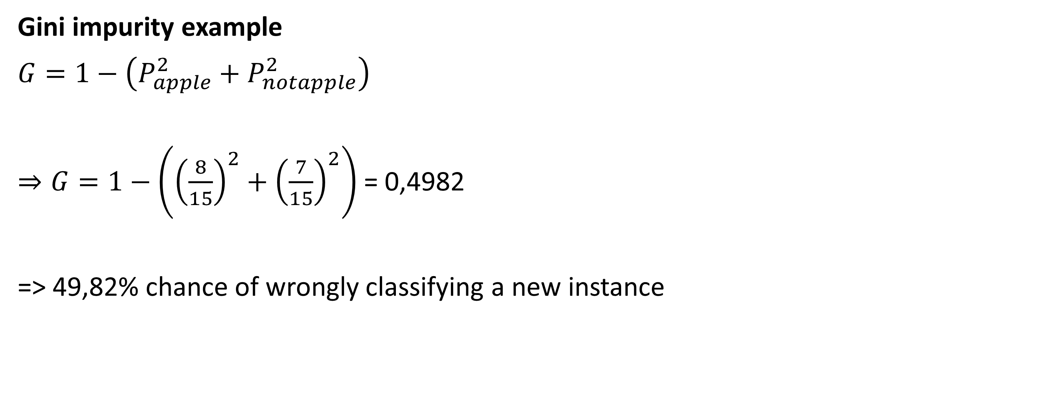
Decision trees
Gini impurity example
$G=1−\left(P_{apple}^{2}+P_{notapple}^{2}\right)$
$⇒G=1−\left({\left(\frac{8}{15}\right)}^{2}+{\left(\frac{7}{15}\right)}^{2}\right)$ = 0,4982
=> 49,82% chance of wrongly classifying a new instance

Slide 15
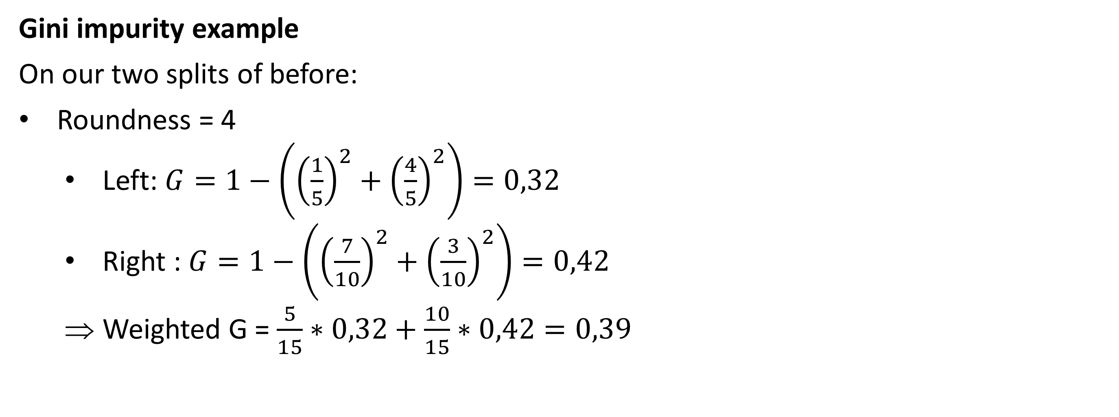
Decision trees
Gini impurity example
On our two splits of before:
Roundness = 4
Left: $G=1−\left({\left(\frac{1}{5}\right)}^{2}+{\left(\frac{4}{5}\right)}^{2}\right)=0,32$
Right : $G=1−\left({\left(\frac{7}{10}\right)}^{2}+{\left(\frac{3}{10}\right)}^{2}\right)=0,42$
Weighted G = $\frac{5}{15}∗0,32+\frac{10}{15}∗0,42=0,39$

Slide 16
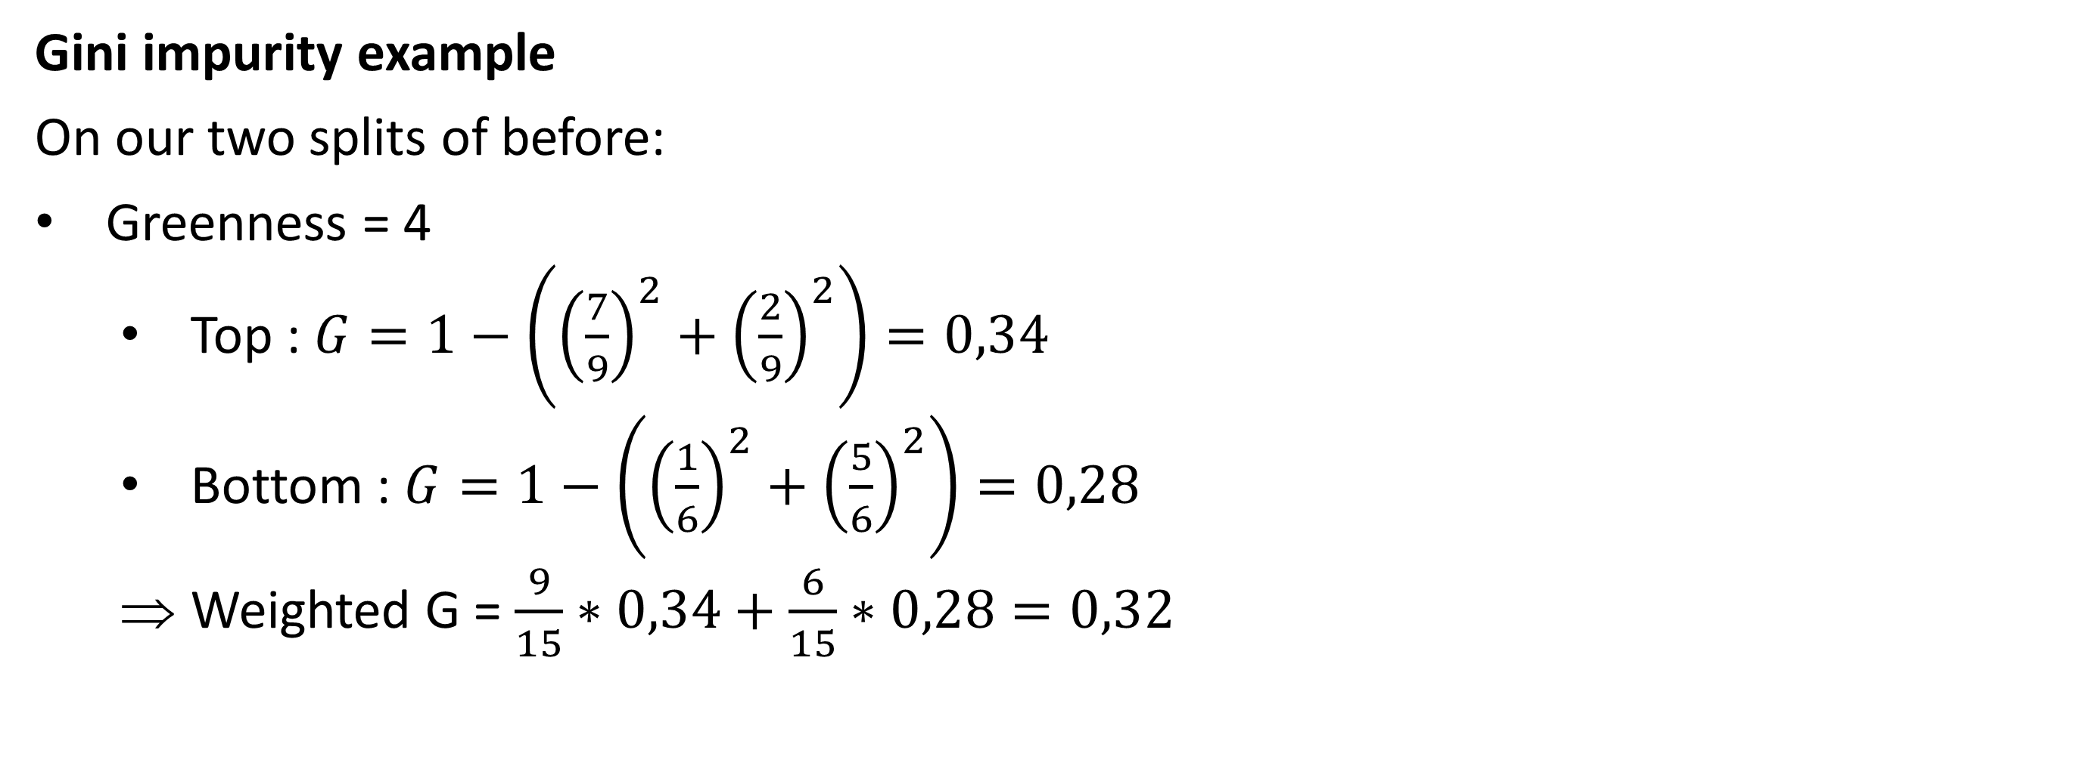
Decision trees
Gini impurity example
On our two splits of before:
Greenness = 4
Top : $G=1−\left({\left(\frac{7}{9}\right)}^{2}+{\left(\frac{2}{9}\right)}^{2}\right)=0,34$
Bottom : $G=1−\left({\left(\frac{1}{6}\right)}^{2}+{\left(\frac{5}{6}\right)}^{2}\right)=0,28$
Weighted G = $\frac{9}{15}∗0,34+\frac{6}{15}∗0,28=0,32$

Slide 17
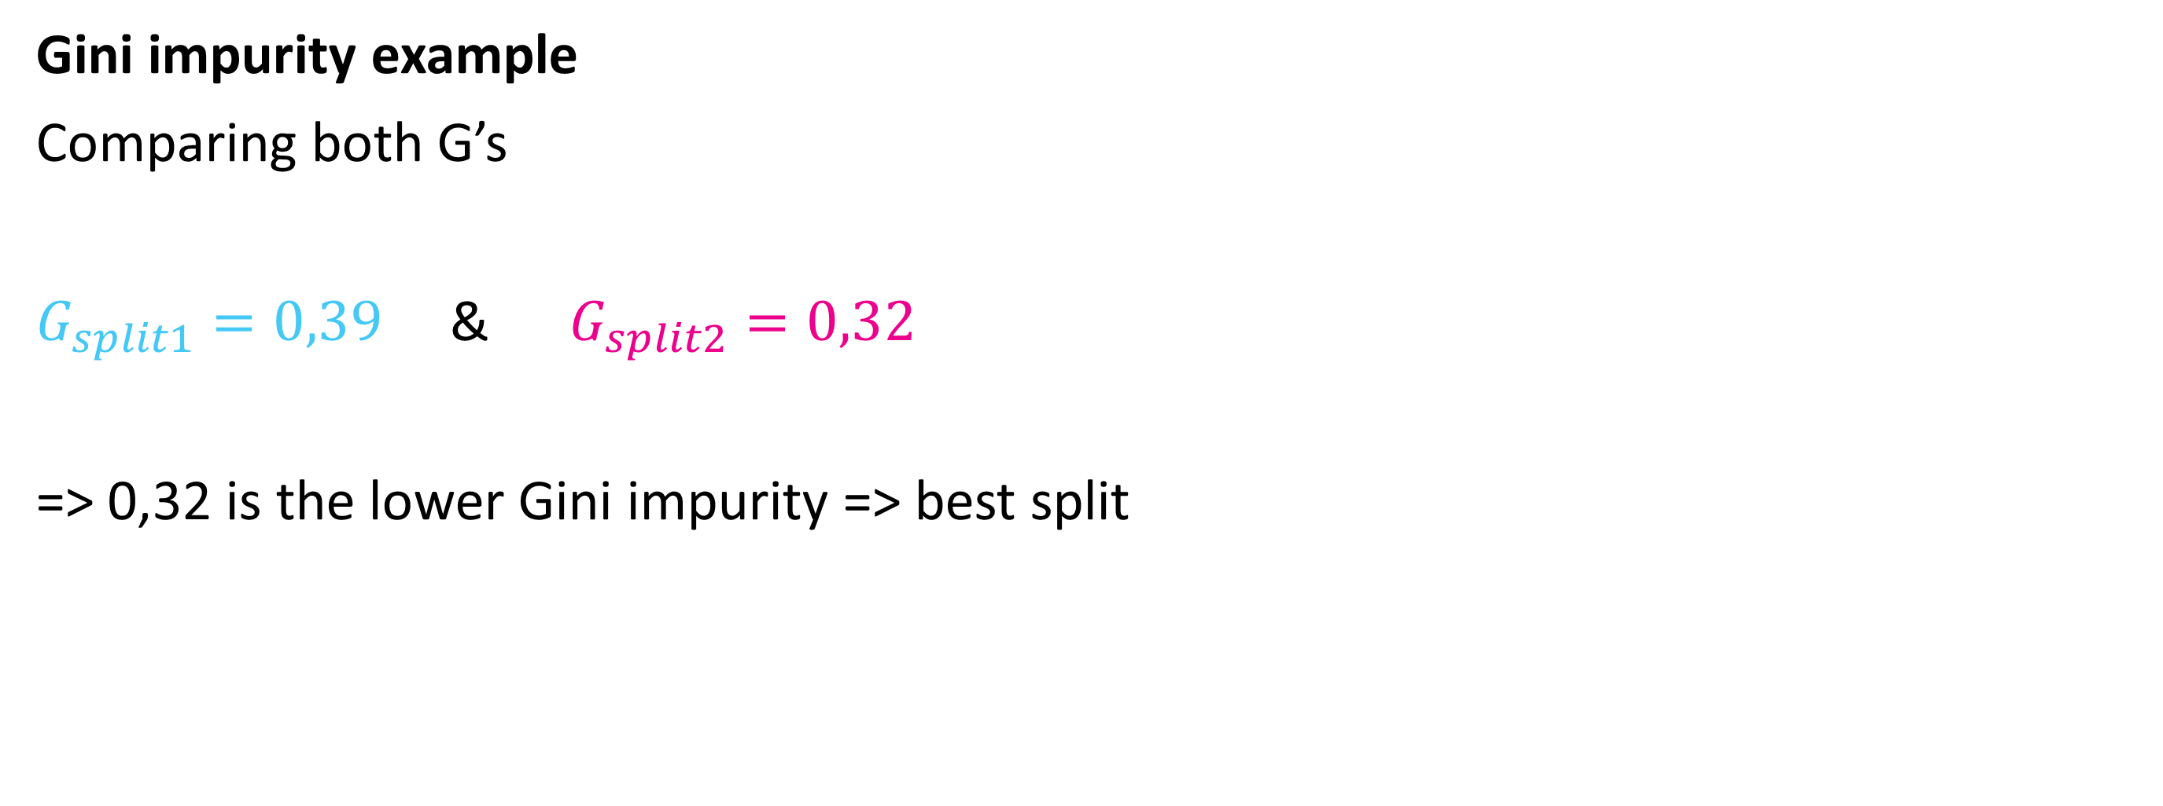
Decision trees
Gini impurity example
Comparing both G’s
$G_{split1}=0,39$ & $G_{split2}=0,32$
=> 0,32 is the lower Gini impurity => best split

Slide 18
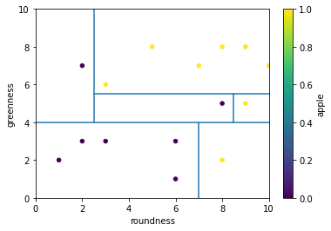
Decision trees
Constructing an entire tree
We tested one split with two possible values
An actual tree would test loads of possible split values and perform more splits on the new subsets.
This would return something like this:

Slide 19
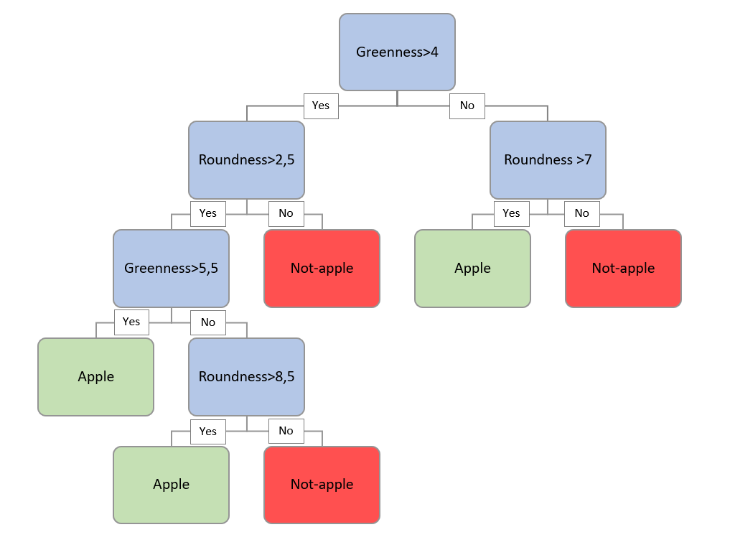
Decision trees
Constructing an entire tree
The tree for such a split dataset would look something like this:

Slide 20
Decision trees
Constructing an entire tree
New sample: roundness = 6 and greenness = 5

Slide 21
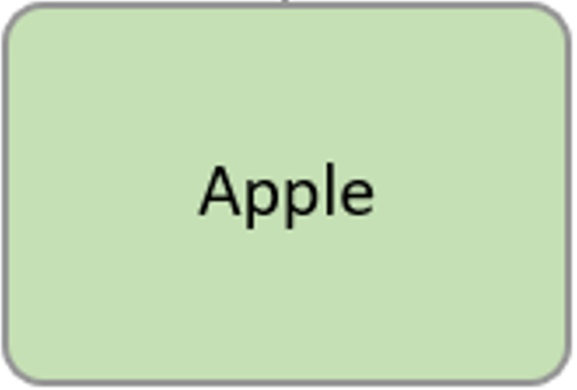
Decision trees
Constructing an entire tree
As we can see, this has a tendency to overfit => different solutions e.g., pruning the tree

Slide 22
Decision trees
Prevent overfitting
There are different options we can use to prevent overfitting of our decision trees.
Pruning the tree
Not allowing your tree to fully separate all cases of your training set
Sklearn hyperparameters:
Pre-pruning (restrictions during tree construction):
max_depth (number of layers your tree is allowed to have)
min_samples_leaf (minimal number of samples a leaf should have)
min_samples_split (minimal number of samples your splits should have)
Post-pruning (restrictions after tree construction):
ccp_alpha (complexity parameter, if tree after construction is to complex, it will cut some branches off)

Slide 23
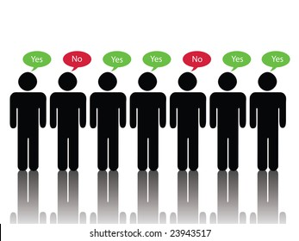
Decision trees
Prevent overfitting
Random forest trees
Instead of using one tree with all our training data, we can make multiple trees on subsets of the training data.
E.g., 50 trees that each train on random subsets of 50% of the training data
Sklearn hyperparameter: max_samples
=> Class is chosen by the class that is predicted by most of the trees (majority voting)

Slide 24
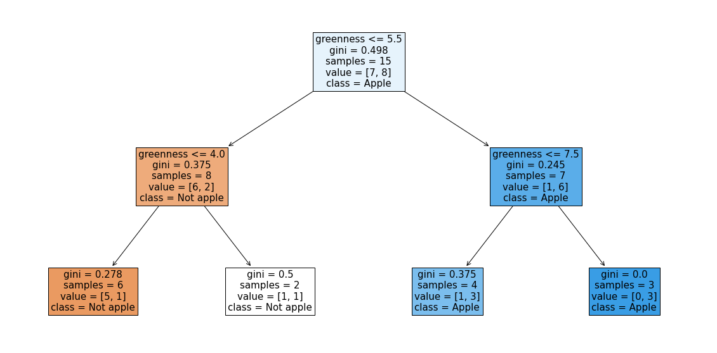
Decision trees
Example of an actual tree from the random forest classifier

Slide 25
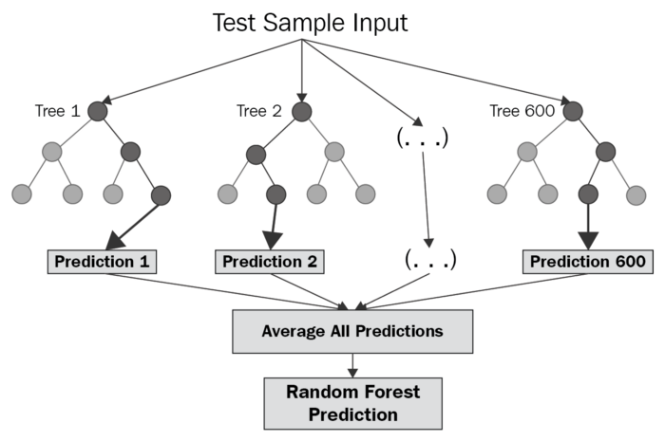
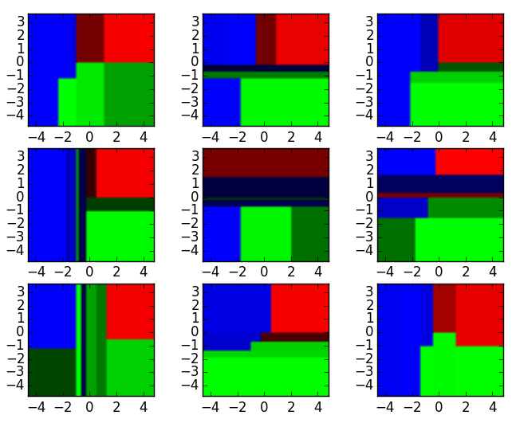
Decision trees
Random forest trees can also be used for regression!
The output of the trees will be a numeric value. The average of the outputs of different trees will be the predicted value
Decision boundaries for 9 different trees, each color represents 1 value

Slide 26
Ensemble learning
A machine learning technique that combines several base models in order to produce one optimal predictive model: “Ensemble learning”
Often has a better performance than a single model
Example: random forest trees

Slide 27
Ensemble learning
3 types of ensemble learning
Stacking
Bagging
Boosting

Slide 28
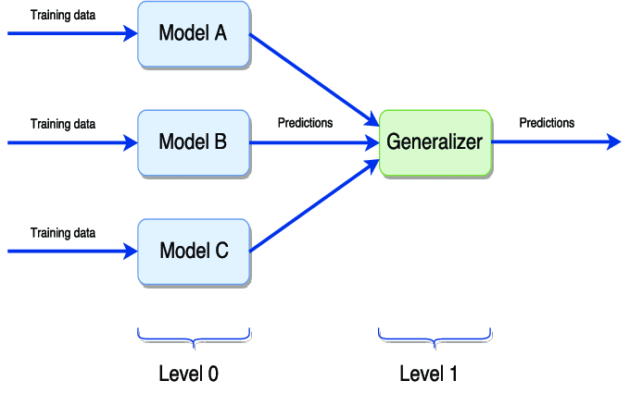
Ensemble learning
Stacking
Train multiple (often different) models on the same training data
Logistic regression
Naïve bayes
…
Send the output of the different classifiers to a final model that predicts the final class
Example: random forest trees with bagging=False

Slide 29
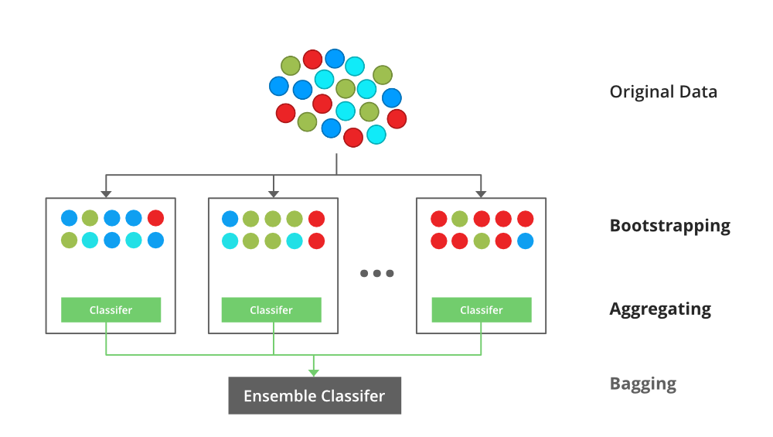
Ensemble learning
Bagging
Short for bootstrap aggregating
Often the same kind of classifier that is used
Create “bags” of subsets of data and train multiple models on these subsets.
Combine the output with a final classifier
Example: Random forest classifier with bootstrap = true

Slide 30
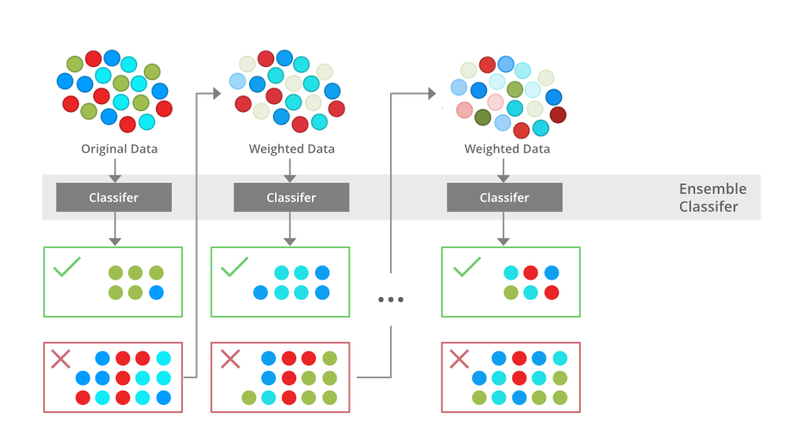
Ensemble learning
Boosting
Similar to bagging, however wrongly classified samples will have a higher chance of being selected in the “bag” of the next classifier.
More prone to overfitting
Not possible to train in parallel (since input of next classifier is determined by the previous one)
Most known algorithm: AdaBoost (Adaptive boosting)

Slide 31
Ensemble learning - sklearn
Stacking
from sklearn.ensemble import StackingClassifier
from sklearn.naive_bayes import MultinomialNB
from sklearn.tree import DecisionTreeClassifier
estimators = [('logisticModel',LogisticRegression(C=10, solver='liblinear')),
('nbModel',MultinomialNB(alpha=1)),
('dtModel',DecisionTreeClassifier(max_depth=1))]
stackClassifier = StackingClassifier(estimators=estimators)
# Fit data
stackClassifier.fit(X_train,y_train)
# Predict testing data
y_pred = stackClassifier.predict(X_test)

Slide 32
Ensemble learning - sklearn
Bagging
from sklearn.linear_model import LogisticRegression
from sklearn.ensemble import BaggingClassifier
# Bagging with logistic regression
number_of_estimators = 100
baseModel = LogisticRegression(C=5,solver='liblinear')
lregbagging = BaggingClassifier(base_estimator=baseModel,
n_estimators=number_of_estimators,
max_features=2)
# Fit our training data
lregbagging.fit(X_train,y_train)
# Predict testing data
y_pred = lregbagging.predict(X_test)

Slide 33
Ensemble learning - sklearn
Boosting
from sklearn.ensemble import AdaBoostClassifier
# When not specifying a specific base estimator, a DecisionTreeClassifier is used (One tree).
clf_adaboost = AdaBoostClassifier(n_estimators=150,learning_rate=0.9)
# Fit data
clf_adaboost.fit(X_train,y_train)
# Predict testing data
y_pred = clf_adaboost.predict(X_test)

